Slide 1


HACKATHON 2024
LNRS HACKATHON 2024

Slide 2
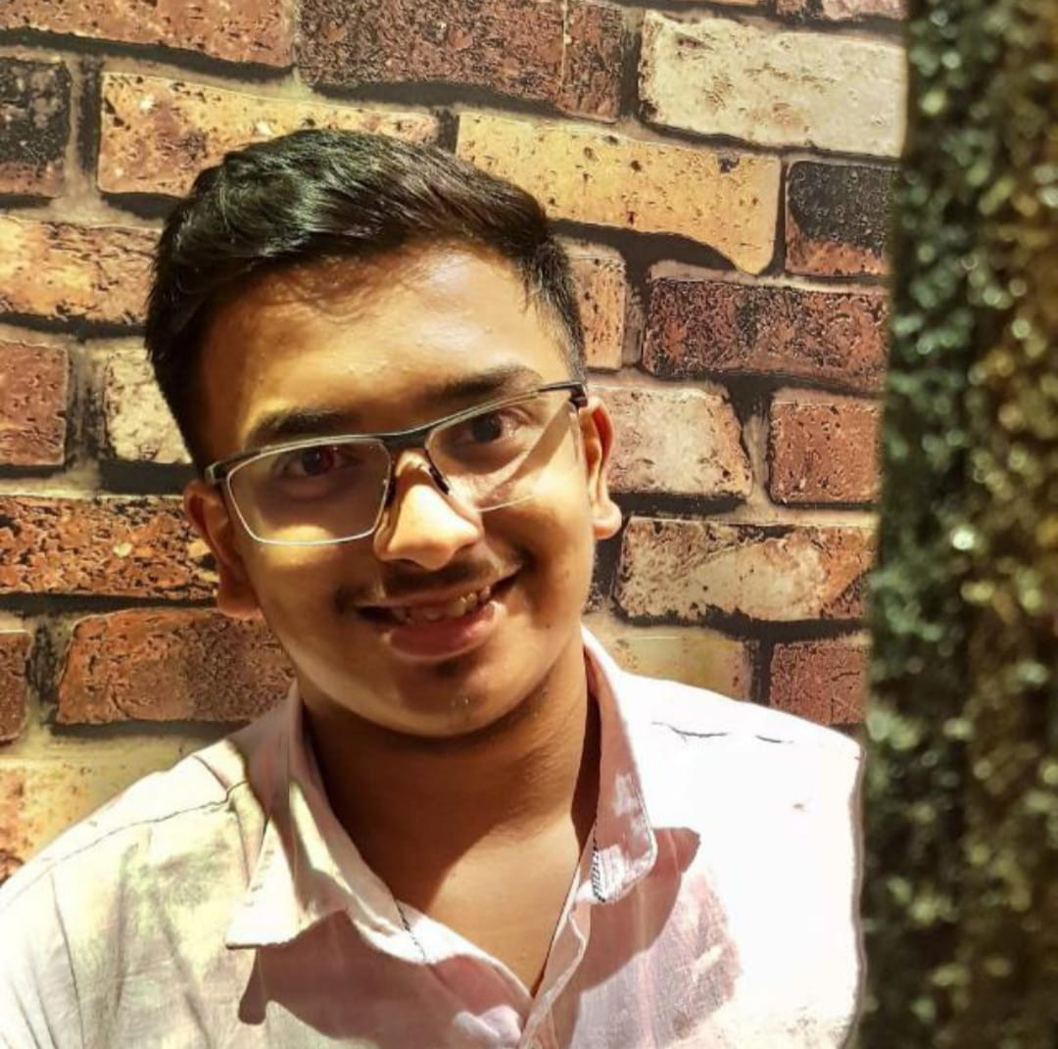
ABOUT ME
Name: Om Valia
Email Id: om.valia034@nmims.in
Contact No: 9004475994
Github Account: https://github.com/omvalia
College: Mukesh Patel School of Technology Management & Engineering, Mumbai
Student Id: 70612300034
Repo Link: https://github.com/omvalia/LNRSHACKATHON_OM_VALIA.git
Topic: Damage Detection through photos or videos

Slide 3
Problem Statement
The purpose of this project is to create an automated system that streamlines the process of damage assessment by extracting, transcribing, and summarizing audio from videos submitted by users for insurance claims.
By leveraging modern AI technologies, the project aims to simplify the claim review process for insurance companies, enabling them to quickly and accurately assess damage claims for car accidents, home renovations, and medical insurance.
This system will allow insurance professionals to focus on more complex tasks while relying on the application to handle the initial summarization and classification of claims.

Slide 4
Project Scope and Objectives
The project scope includes developing an application that can process user-submitted videos for the purpose of damage detection in three key insurance categories: car, home renovation, and medical.
The primary objective is to provide a seamless and user-friendly interface where users can upload videos, and the system automatically extracts audio, converts it to text, and summarizes it based on predefined templates.
This summary will then be used by insurance companies to conduct a first-level review of the claim.
Additionally, the system should ensure accurate and fast processing to meet the demands of both users and insurance companies. Future enhancements may include support for additional claim types and expanded language options.

Slide 5
Plan of Action and Tech Stack
Streamlit (Frontend): Streamlit provides a user-friendly interface for uploading videos, interacting with the system, and viewing summarized results.
Python (Backend): Python manages backend operations, handling audio extraction, transcription, and summarization while integrating with APIs to process video data efficiently.
moviepy (Audio Extraction): moviepy extracts audio from videos, preparing it for transcription.
Whisper API (Transcription): Whisper converts the extracted audio into text, enabling accurate transcription for further summarization.
Gemini API (Summarization): Gemini generates structured summaries based on transcriptions, following a predefined template for each insurance claim type.

Slide 6
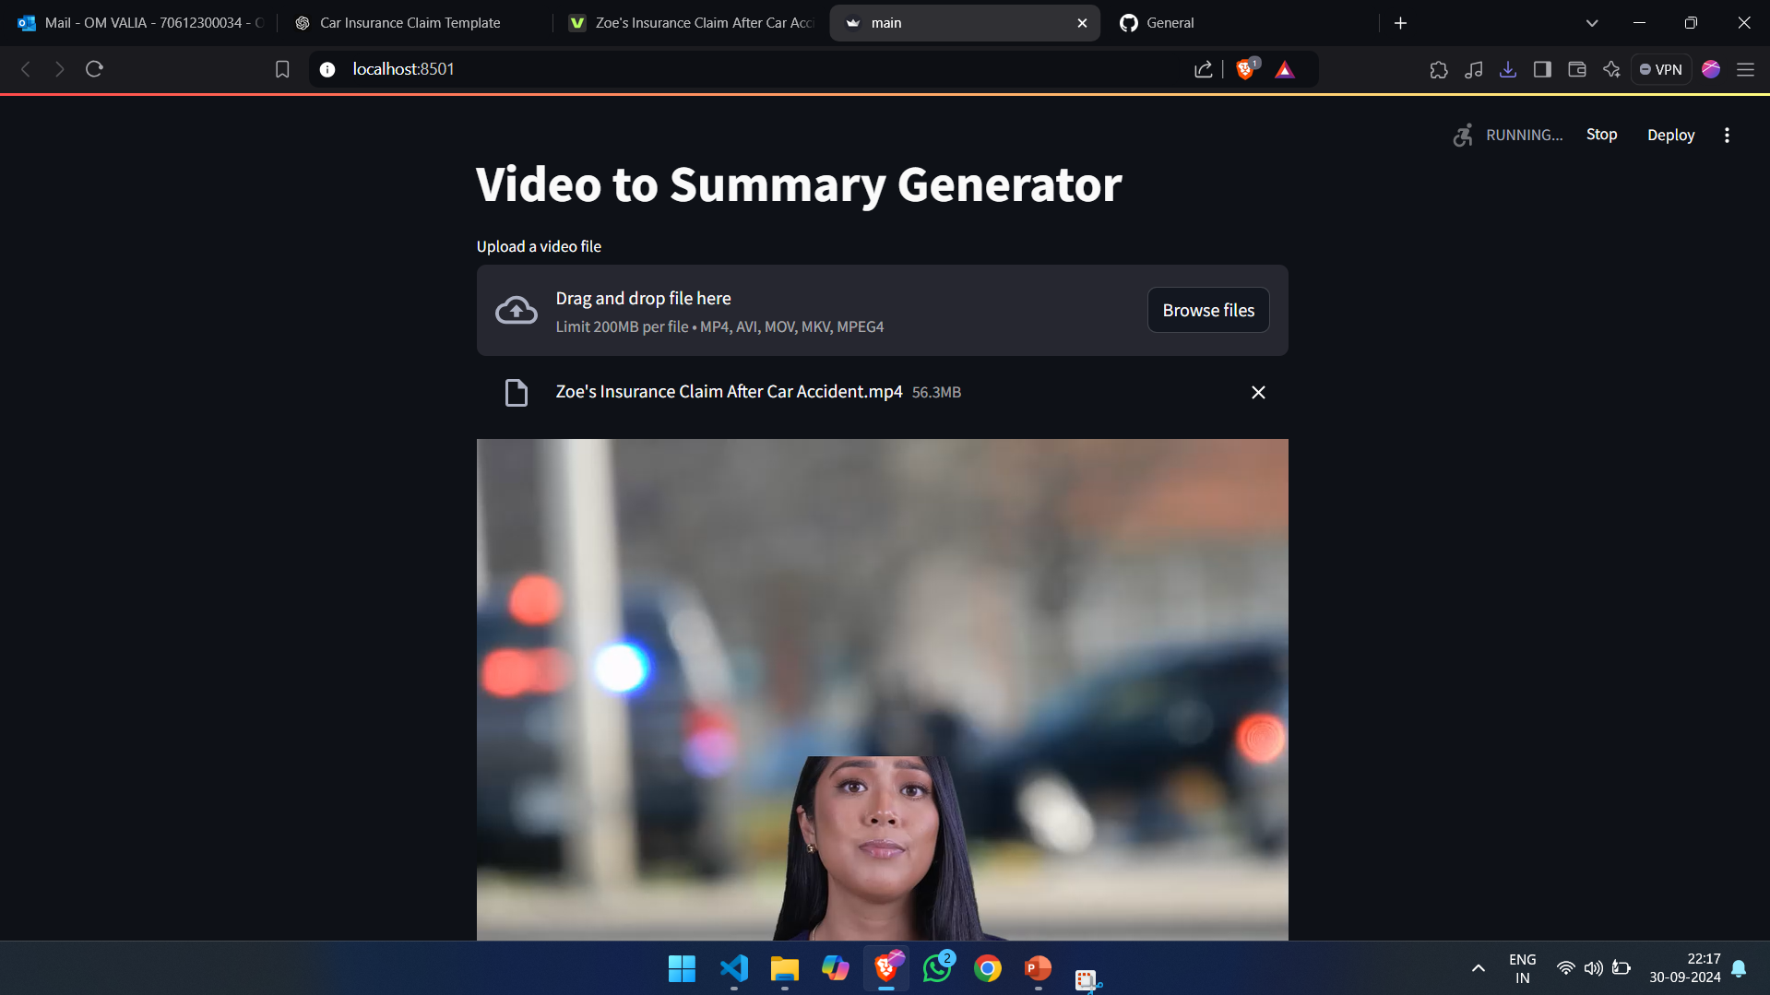
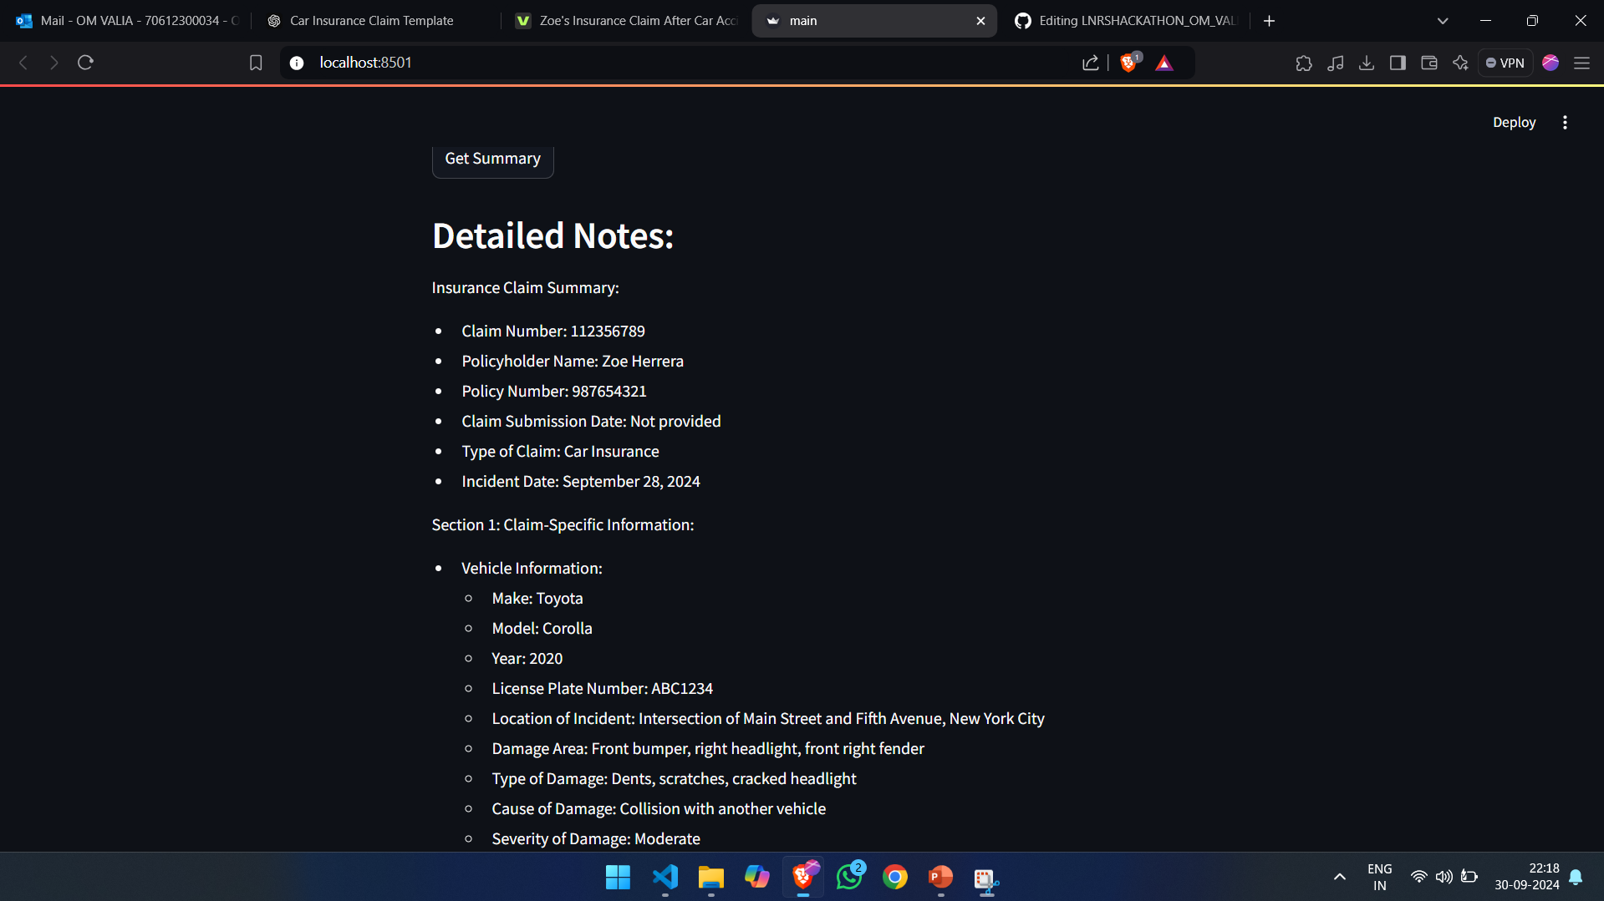
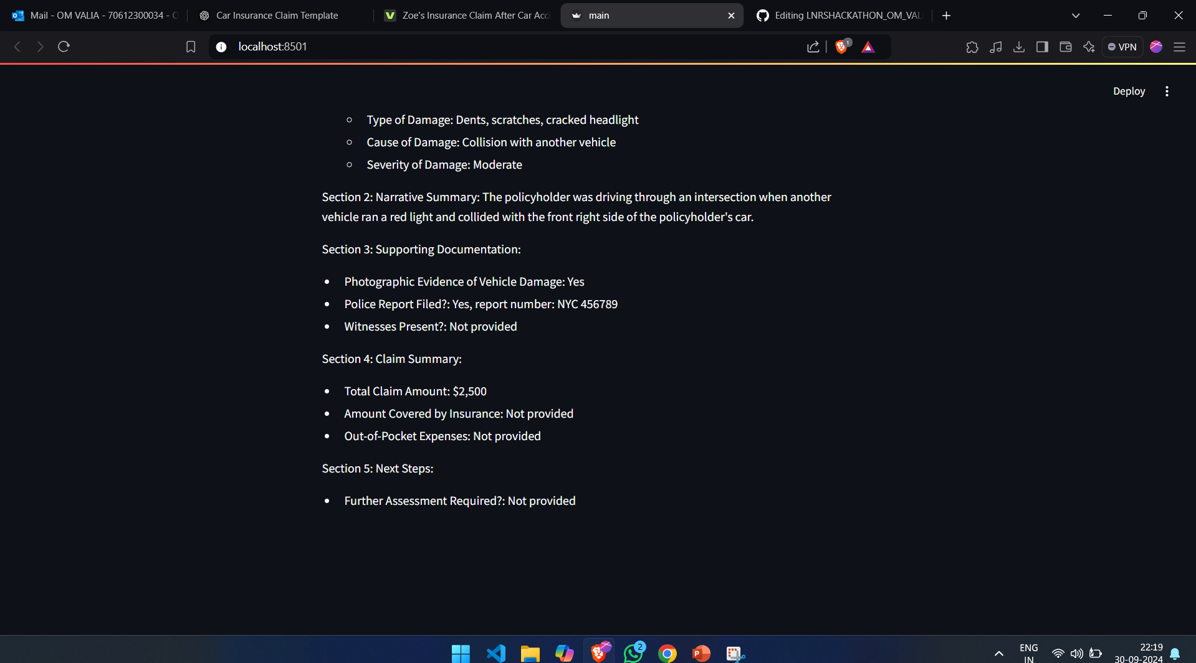
Project Demo
Car Insurance Claim

Slide 7
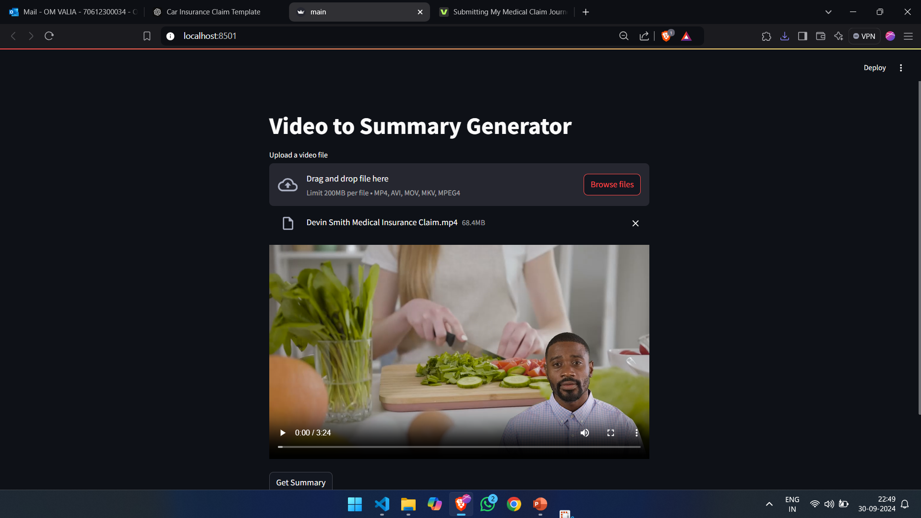
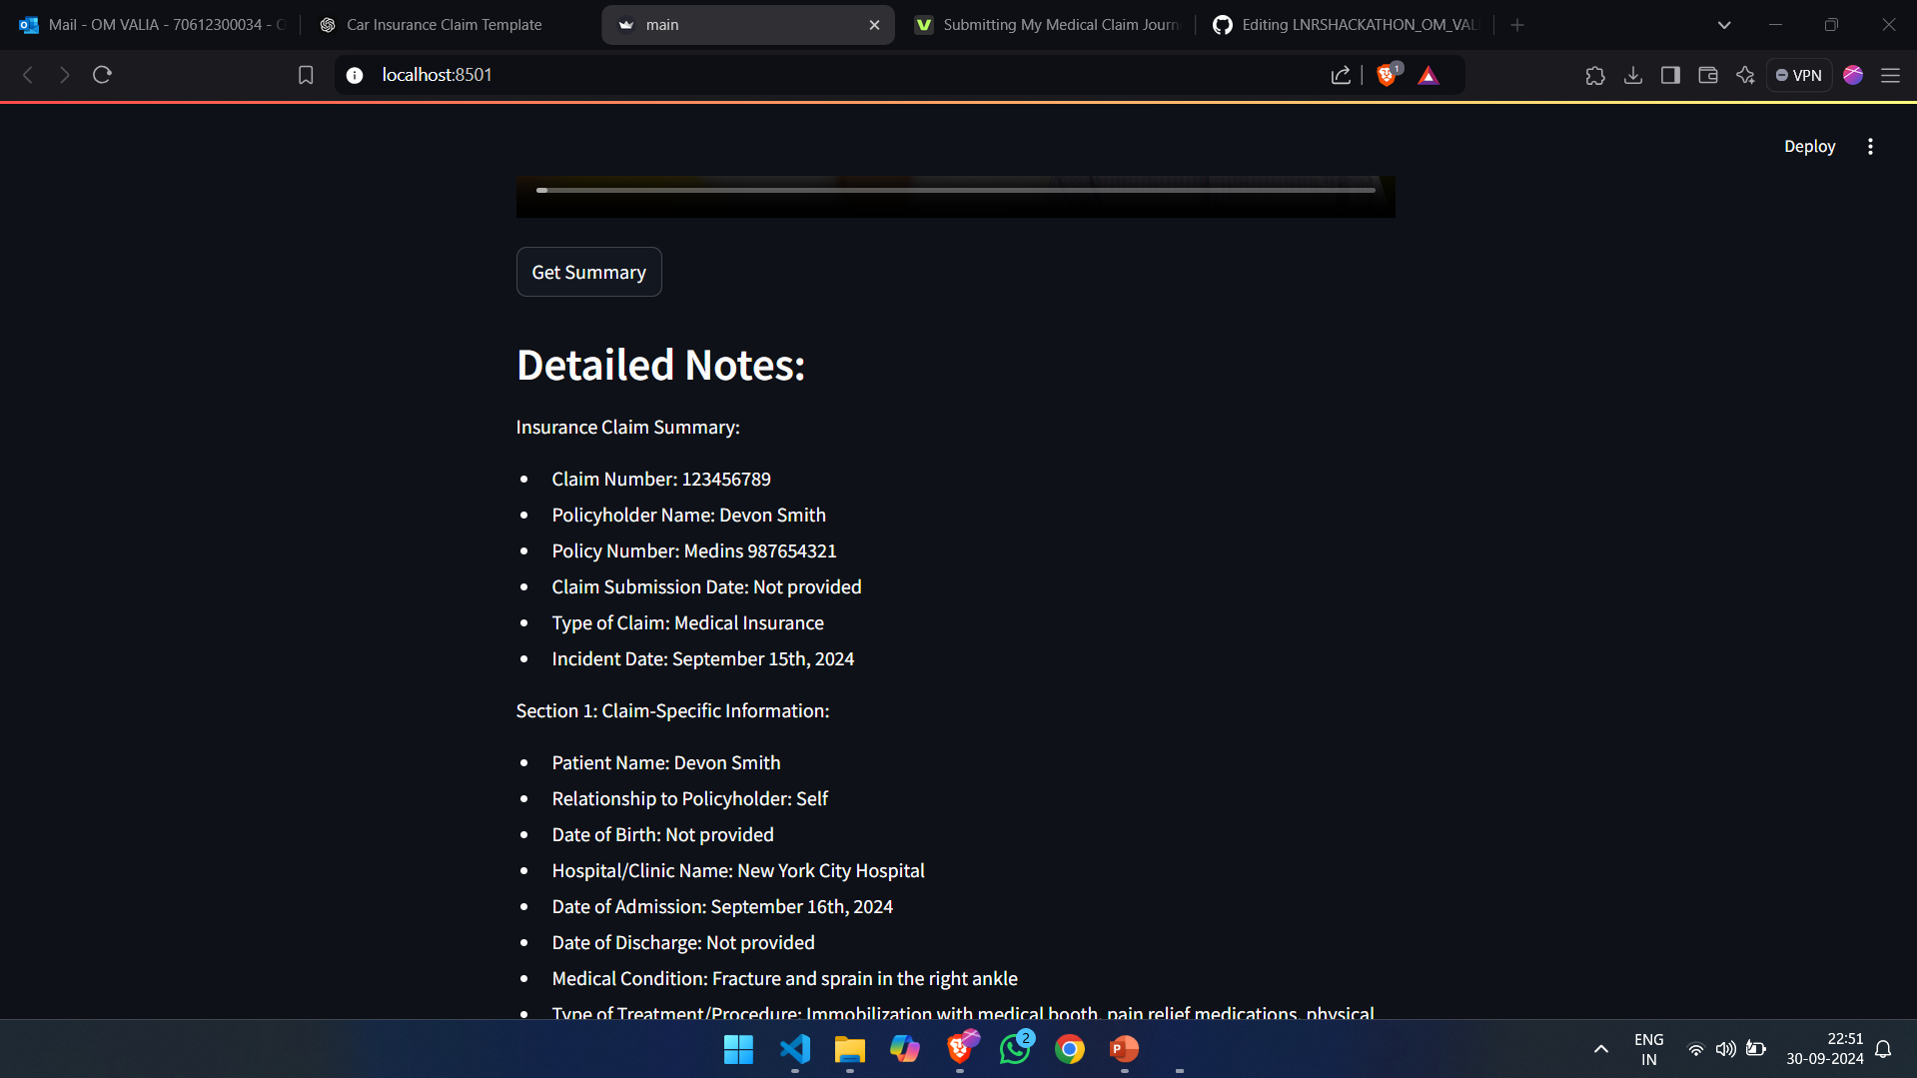
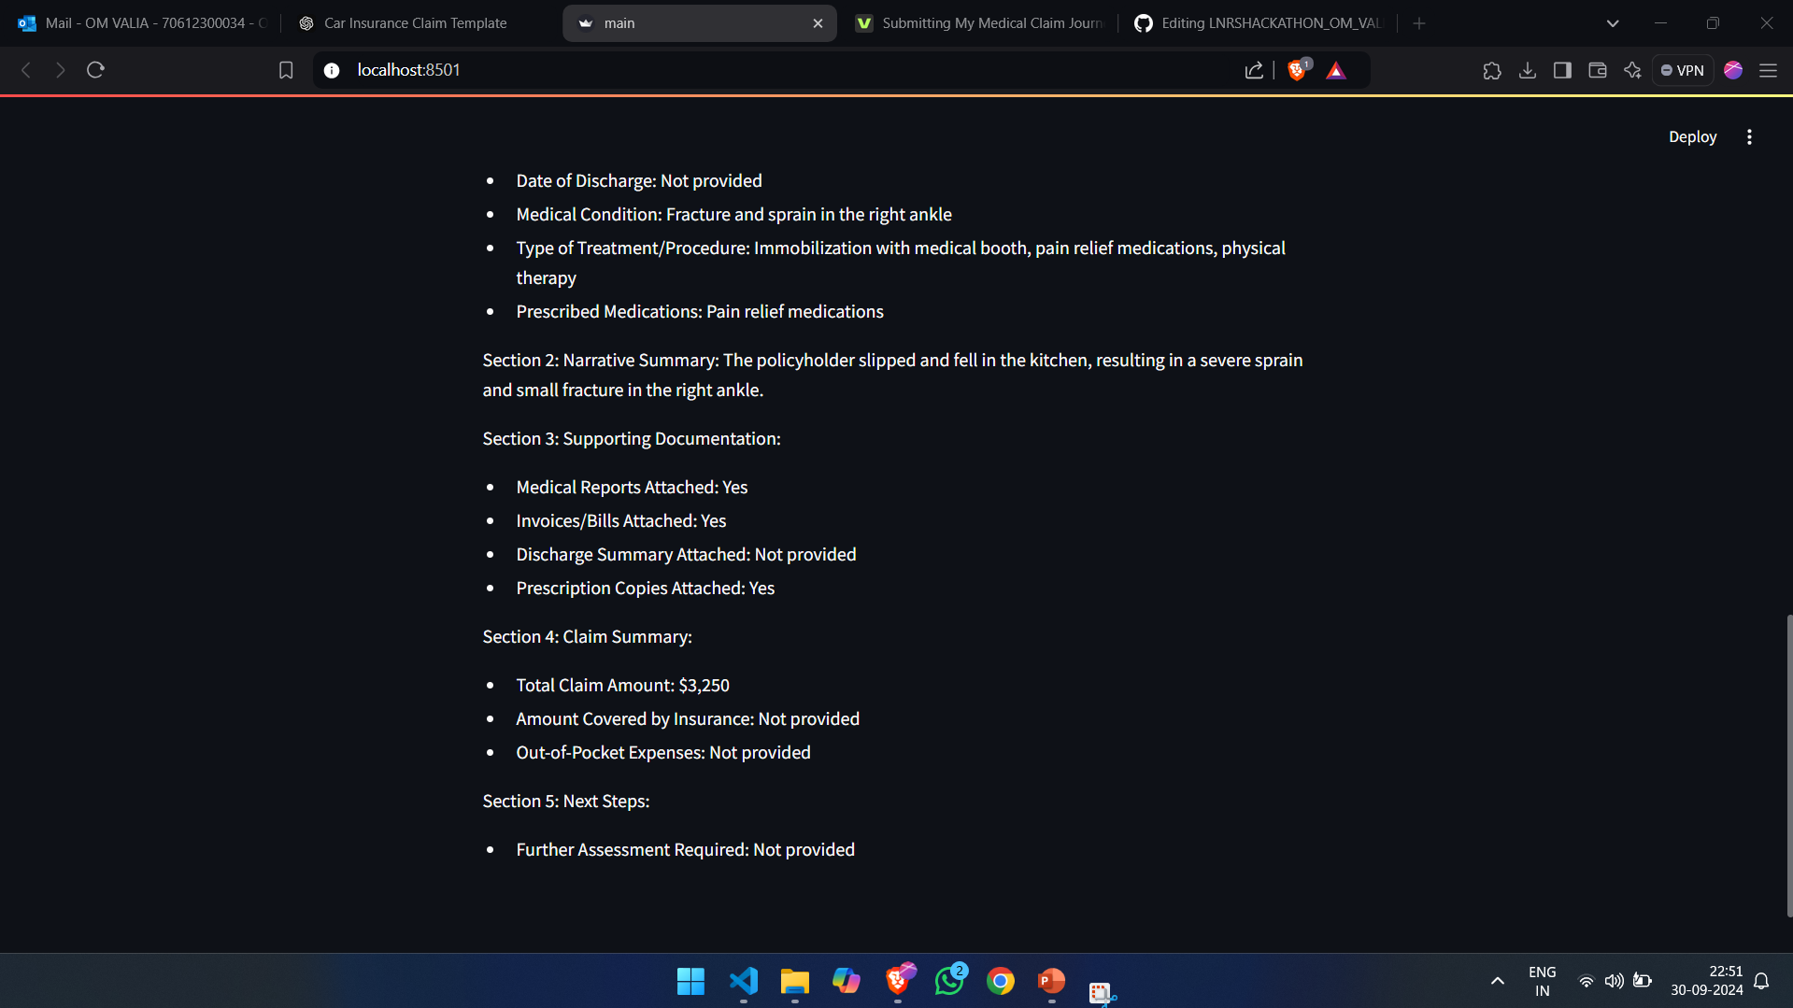
Project Demo
Medical Insurance Claim

Slide 8
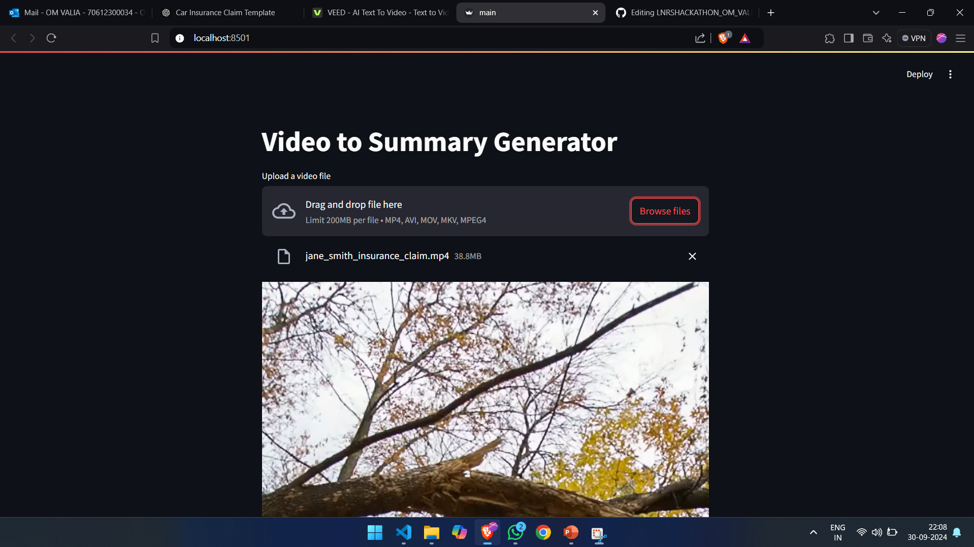
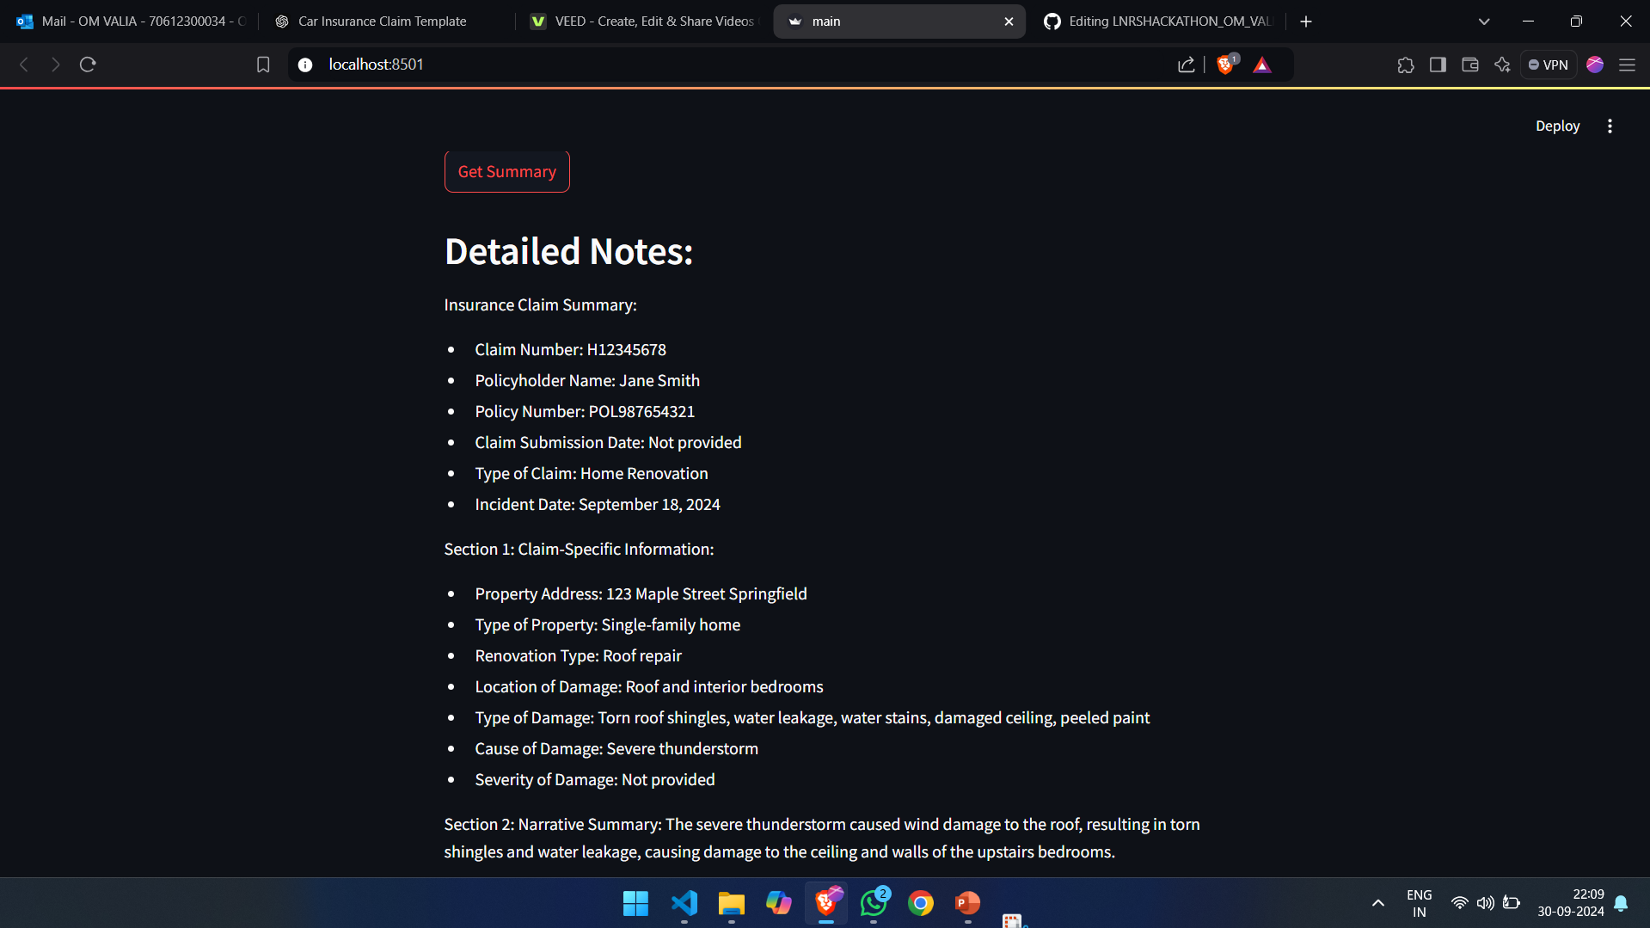
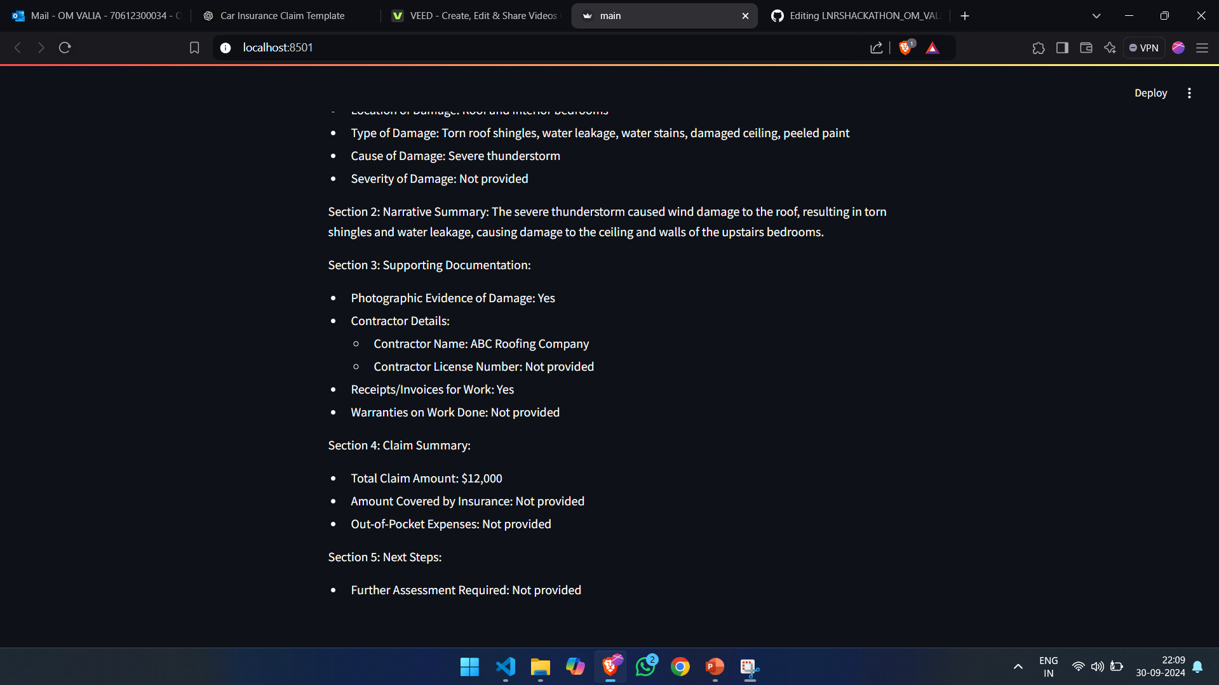
Project Demo
Home Renovation Insurance Claim

Slide 9
Project Demo
Home Renovation Insurance Claim

Slide 10
Conclsuion
In conclusion, this project leverages modern AI technologies to streamline the damage assessment process for insurance claims. By automating the extraction, transcription, and summarization of user-submitted video content, the system provides insurance companies with efficient and accurate first-level reviews. Targeting car, home renovation, and medical insurance claims, the application not only enhances claim processing but also reduces manual effort, allowing for faster decision-making. With future potential for expansion, this solution represents a significant step forward in transforming insurance workflows.

Slide 11
References
The following resources were referenced during the development of this project:
https://www.youtube.com/watch?v=HFfXvfFe9F8
https://www.youtube.com/watch?v=HbY51mVKrcE
https://www.youtube.com/watch?v=LEDpgye3bf4

